Slide 1


Slide 2



HORIZON EUROPE
EURATOM
Specific Programme: European Defence Fund
Specific Programme implementing Horizon Europe & EIT*
Exclusive focus on civil applications
Fusion
Pillar I
Excellent Science
Pillar II
Global Challenges & European Industrial Competitiveness
Pillar III
Innovative Europe
Exclusive focus on defence research
& development
European Research Council
Health
Culture, Creativity & Inclusive Society
Civil Security for Society
Digital, Industry & Space
Climate, Energy & Mobility
Food, Bioeconomy, Natural Resources, Agriculture & Environment
European Innovation Council
Fission
Research actions
Marie Skłodowska-Curie
Clusters
European Innovation Ecosystems
Research Infrastructures
European Institute of Innovation & Technology*
Development actions
Joint Research Centre
Joint Research Center
Widening Participation and Strengthening the European Research Area
Widening participation & spreading excellence
Reforming & Enhancing the European R&I system
* The European Institute of Innovation & Technology (EIT) is not part of the Specific Programme

Slide 3
Horizon Europe Budget: €95.5 billion (2021-2027)
(including €5.4 billion from NGEU – Next Generation Europe – programme of EU for Recovery from COVID-19 crisis)
Political agreement December 2020
€ billion in current prices

Slide 4

European Innovation Council
Support to innovations with breakthrough and disruptive nature and scale up potential that are too risky for private investors (70% of the budget earmarked for SMEs)
Helping researchers and innovators create markets of the future, leverage private finance, scale up their companies
Innovation centric, risk taking & agile, pro-active management and follow up
Mostly ’bottom up’, but also targeting strategic challenges
EIC Programme Managers to develop visions for breakthroughs and steer portfolios
European
Innovation Council –
a one-stop-shop
Complementary instruments bridging the gap from idea to market
Pathfinder
R&I grants
(from early technology
to proof of concept)
Transition
R&I grants
(proof of concept to
pre-commercial)
Accelerator
Grants & investment (via EIC Fund) for single SMEs & start-ups
(from pre-commercial to market & scale-up)

Slide 5

EU Missions
Relating EU's research and innovation better to society and citizens' needs; with strong visibility and impact
R&I Missions
A mission is a portfolio of actions across disciplines intended to achieve a bold and inspirational and measurable goal within a set timeframe, with impact for society and policy making as well as relevance for a significant part of the European population and wide range of European citizens.
Horizon Europe defines mission characteristics and elements of governance, and 5 missions areas. Specific missions will be programmed within the Global Challenges and European Industrial Competitiveness pillar, but may also benefit from actions carried out within other parts of the Programme as well as complementary actions carried out under other Union programmes.

Slide 6





Five Missions Areas
Adaptation to climate change, including societal transformation
Cancer
Healthy oceans, seas, coastal & inland waters
Climate-neutral & smart cities
Soil health & food

Slide 7

European Partnerships in Horizon Europe
New generation of objective-driven and more ambitious partnerships in support of
agreed EU policy objectives
  Strategic orientation
  Systemic approach
  Simple architecture and toolbox
  Common set of criteria for the life-cycle
Key Features
Co-programmed
Based on Memoranda of Understanding/contractual arrangements; implemented independently by the partners and by Horizon Europe
Co-funded
Based on a joint programme agreed and implemented by partners; commitment of partners for financial and in-kind contributions
Institutionalised
Based on long-term dimension and need for high integration; partnerships based on Art 185/187 of TFEU and the EIT legal acts for 2021-2027

Slide 8

International Cooperation
Tackling together global societal challenges; access to the world's best talents, expertise and resources; enhanced supply and demand of innovative solutions
International
Cooperation
Association to Horizon Europe
Third countries with good capacity in science, technology and innovation
Taking into account objective of driving economic growth in Europe through innovation
Intensified targeted actions
Strengthened support to multilateral cooperation
Openness to international participation balanced with the promotion of EU
strategic autonomy

Slide 9

Open Science across the programme
Mainstreaming of open science practices for improved quality and efficiency of R&I, and active engagement
of society
Open
Science
Mandatory immediate Open Access to publications: beneficiaries must retain sufficient IPRs to comply with open access requirements;
Data sharing as ‘open as possible, as closed as necessary‘: mandatory Data Management Plan for FAIR (Findable, Accessible, Interoperable, Reusable) research data
Work Programmes may incentivize or oblige to adhere to open science practices such as involvement of citizens, or to use the European Open Science Cloud
Assessment of open science practices through the award criteria for proposal evaluation
Dedicated support to open science policy actions
Open Research Europe publishing platform

Slide 10



Horizon Europe Stats
  23 624 signed grants
  Out of 176 011 eligible proposals
  Success rate: 13.65%
  77.84 B€ eu contribution
  Largest contribution for the Project Partnership for the Assessment of Risks from Chemicals (PARC, €200M)
  145 049 participations
  35 135 unique participants
  25 972 SME Participations

Slide 11
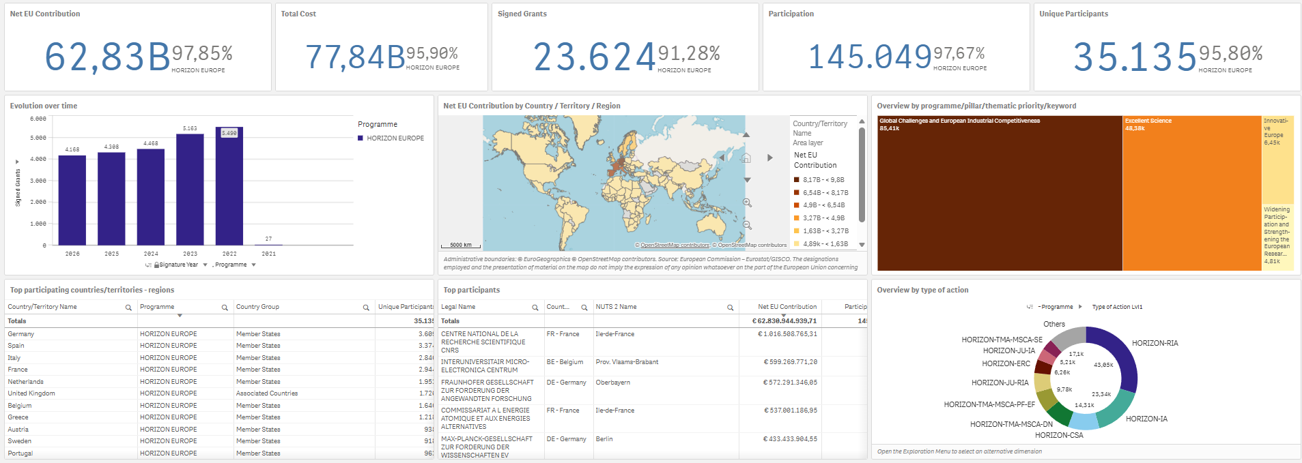
Horizon Europe – State of Play
More data: See Horizon Dashboard

Slide 12
In detail
HORIZON EUROPE

Slide 13
Pillar I
EXCELLENT SCIENCE:
reinforcing and extending the excellence of the Union's science base
European Research Council
Frontier research by the best researchers and their teams
Marie Skłodowska-
Curie Actions
Equipping researchers with new knowledge
and skills through mobility and training
Research Infrastructures
Integrated and inter-connected world-class research infrastructures
€16 billion
€6.6 billion
€2.4 billion

Slide 14
Pillar II - Clusters
Global Challenges & European Industrial Competitiveness:
boosting key technologies and solutions underpinning EU policies & Sustainable Development Goals (6 clusters and JRC – non-nuclear direct actions)
Health
Culture, Creativity & Inclusive Societies
Civil Security for Society
Digital, Industry & Space
Climate, Energy & Mobility
Food, Bioeconomy, Natural Resources, Agriculture & Environment
€53.5 billion

Slide 15
Pillar II
Budget for clusters & for JRC
in current prices
Cluster 1 | Health | €8.246 billion (including €1.35 billion from NGEU)
Cluster 2 | Culture, Creativity & Inclusive Societies | €2.280 billion
Cluster 3 | Civil Security for Society | €1.596 billion
Cluster 4 | Digital, Industry & Space | €15.349 billion (including €1.35 billion from NGEU)
Cluster 5 | Climate, Energy & Mobility | €15.123 billion (including €1.35 billion from NGEU)
Cluster 6 | Food, Bioeconomy, Natural Resources, Agriculture & Environment | €8.952 billion
 | JRC (non-nuclear direct actions) | €1.970 billion
Clusters are including a budget for Partnerships and Missions
NGEU is Next Generation EU programme – Recovery Fund

Slide 16
Pillar III
INNOVATIVE EUROPE:
stimulating market-creating breakthroughs and ecosystems conducive to innovation
European Innovation Council
Support to innovations with breakthrough and market creating potential
European
innovation ecosystems
Connecting with regional and national innovation actors
European Institute
of Innovation and Technology (EIT)
Bringing key actors (research, education and business) together around a common goal for nurturing innovation
The budget: €10.6 billion, incl. up to €527 million for ecosystems (including NGEU – Recovery Fund parts dedicated to EIC).
circa €3 billion

Slide 17
Part
Widening Participation & Strengthening the European Research Area (ERA):
Widening Participation and Spreading Excellence
Teaming, Twinning, ERA Chairs,
European Cooperation in Science and Technology (COST)
Boosting National Contact Points‘ (NCPs) activities, pre-proposal checks and advice
Brain circulation
Excellence initiatives
Possibility for entities from widening countries to join already selected collaborative R&I actions
Recognition of participation
Matchmaking services
Reforming and enhancing the EU R&I system
Strengthening the evidence base for R&I policy
Foresight
Support for policy makers to the ERA development
Support to national R&I policy reform, including Policy Support Facility
Attractive researcher careers and links with higher education
Open science, citizen science and science communication
Gender equality
Ethics and integrity
Support to international cooperation
Scientific input to other policies
Support to the Programme implementation
Support for National Contact Points
Support to dissemination & exploitation
€2.96 billion
€0.44 billion

Slide 18
Impact
HORIZON EUROPE

Slide 19

Horizon Europe legislation defines three types of impact tracked through Key Impact Pathways
Scientific
Impact
1. Creating high-quality new knowledge
2. Strengthening human capital in R&I
3. Fostering diffusion of knowledge and Open Science
Societal
Impact
4. Addressing EU policy priorities & global challenges through R&I
5. Delivering benefits & impact via R&I missions
6. Strengthening the uptake of R&I in society
Economic
Impact
7. Generating innovation-based growth
8. Creating more and better jobs
9. Leveraging investments in R&I

Slide 20
Horizon europe –the Strategic plan 2025-2027

Slide 21
Simplified key strategic orientations
Key Strategic Orientation A
Promoting an open strategic autonomy by leading the development of key digital, enabling and emerging technologies, sectors and value chains to accelerate and steer the digital and green transitions through human-centred technologies and innovations
Key Strategic Orientation B
Restoring Europe’s ecosystems and biodiversity, and managing sustainably natural resources to ensure food security and a clean and healthy environment
Green transition
Digital transition
A more resilient, competitive, democratic and inclusive Europe
Key Strategic Orientation C
Making Europe the first digitally enabled circular, climate-neutral and sustainable economy through the transformation of its mobility, energy, construction and production systems
Key Strategic Orientation D
Creating a more resilient, inclusive and democratic European society, prepared and responsive to threats and disasters, addressing inequalities and providing high-quality health care, and empowering all citizens to act in the green and digital transitions

Slide 22
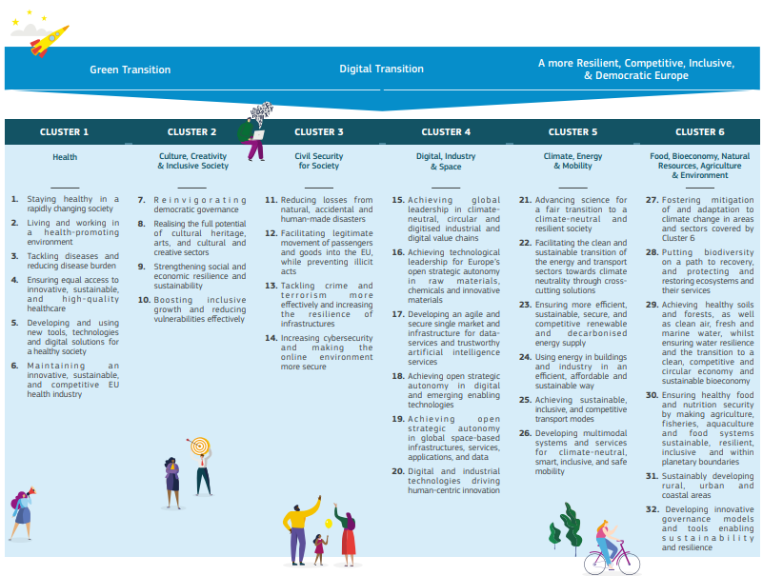
Simplified expected impacts

Slide 23
2nd set of European Partnerships: Overview
Title | Envisioned implementation mode | Cluster
Brain Health | Co-funded | 1
Forests and Forestry for a Sustainable Future | Co-funded | 6
Innovative Materials for EU (I’M for EU) | Co-programmed | 4
Raw Materials for the Green and Digital Transition | Co-funded | 4
Resilient Cultural Heritage | Co-funded | 2
Social Transformations and Resilience | Co-funded | 2
Solar Photovoltaics | Co-programmed | 5
Textiles of the future | Co-programmed | 4
Virtual Worlds | Co-programmed | 4

Slide 24
Thank you!
#HorizonEU
http://ec.europa.eu/horizon-europe

